Slide 1




GRADE 9-10 · AP PRECALCULUS · UNIT 1
Topic 1.13
Function Model
Selection
Journey of 6 stations, 60 minutes
Polynomial and Rational Functions
Mr Malek Thiab
FAITH, RIGHTEOUSNESS AND WISDOM
Notes:
Speaker notes: Welcome to Topic 1.13: Function Model Selection.
Timing: 60 minutes (Diagnose 6, Targeted Instruction 18, Practice 12, Production 12, Mastery Gate 6, Smart Production 6). For a 40-minute class scale every station by two thirds.
The journey map on the next slide shows the six stations; in slideshow mode the Morph transition zooms the station circles into the breadcrumb at the top of every later slide.

Slide 2


Today's journey
Six stations. Each one zooms in as we arrive.
Targeted Instruction
18 min
Production
12 min
Smart Production
6 min
2
4
6
1
3
5
Diagnose
6 min
Practice
12 min
Mastery Gate
6 min
FAITH, RIGHTEOUSNESS AND WISDOM
Notes:
Speaker notes: This is the whole map. Walk it left to right: Diagnose (what we already know), Targeted Instruction (Choosing a function type from the data; Degree n and geometric contexts; Assumptions and restrictions), Practice (Practice, Apply, Investigate), Production (ticket revenue for a science fair), Mastery Gate (three questions to pass), Smart Production (create, then Time to Check).
In slideshow mode the Morph transition animates these circles shrinking into the breadcrumb on later slides; without Morph the slides fade.
Ask the class which station they think will be hardest.

Slide 3
What we are learning
OBJECTIVES
VOCABULARY
Identify an appropriate function type to construct a function model for a given scenario.
Describe assumptions and restrictions related to building a function model.
function model
linear function
quadratic function
cubic function
polynomial function
nth differences
piecewise-defined function
assumption
domain restriction
range restriction
STANDARDS
LO 1.13.A Identify an appropriate function type to construct a function model for a given scenario.
LO 1.13.B Describe assumptions and restrictions related to building a function model.
LO 1.13.A · LO 1.13.B
FAITH, RIGHTEOUSNESS AND WISDOM
Mr Malek Thiab · 3
Notes:
Speaker notes: Read the objectives aloud one at a time and have students say which one they feel least sure about.
Vocabulary used today: function model, linear function, quadratic function, cubic function, polynomial function, nth differences, piecewise-defined function, assumption, domain restriction, range restriction.
Standards are listed on this slide.
The essential question and mathematical practices are not shown because they are not in the project documents; add them from the curriculum map if you want them displayed.

Slide 4
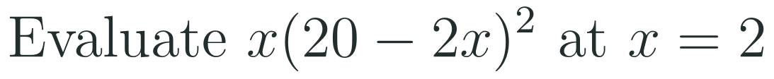
1
2
3
4
5
6
STATION 1 · DIAGNOSE · 6 MIN
Start here: three quick checks
1
2
3
Done when
All three answers are written without a calculator, and you can say what the differences tell you about the data.
LO 1.13.A · LO 1.13.B
FAITH, RIGHTEOUSNESS AND WISDOM
Mr Malek Thiab · 4
Notes:
Speaker notes (Diagnose, 6 min, no calculator):
Speaker notes (Diagnose, 6 min, no calculator).
Solutions: Q1 (11 - 3)/(3 - 1) = 4. Q2 5 - 2 = 3, 10 - 5 = 5, 17 - 10 = 7: differences 3, 5, 7. Q3 2(20 - 4)^2 = 2(256) = 512.
Verbal misconceptions: 'slope is run over rise'; 'the differences must be equal for every data set'; '2(20 - 2(2))^2 = (2)(16)(2)' (the square applies to the bracket only).
Adaptive routing: if more than 30% miss Q1 or Q2, route to slide 5 (finding the type from differences). If Q3 is missed by more than 30%, route to slide 7 (restrictions).

Slide 5


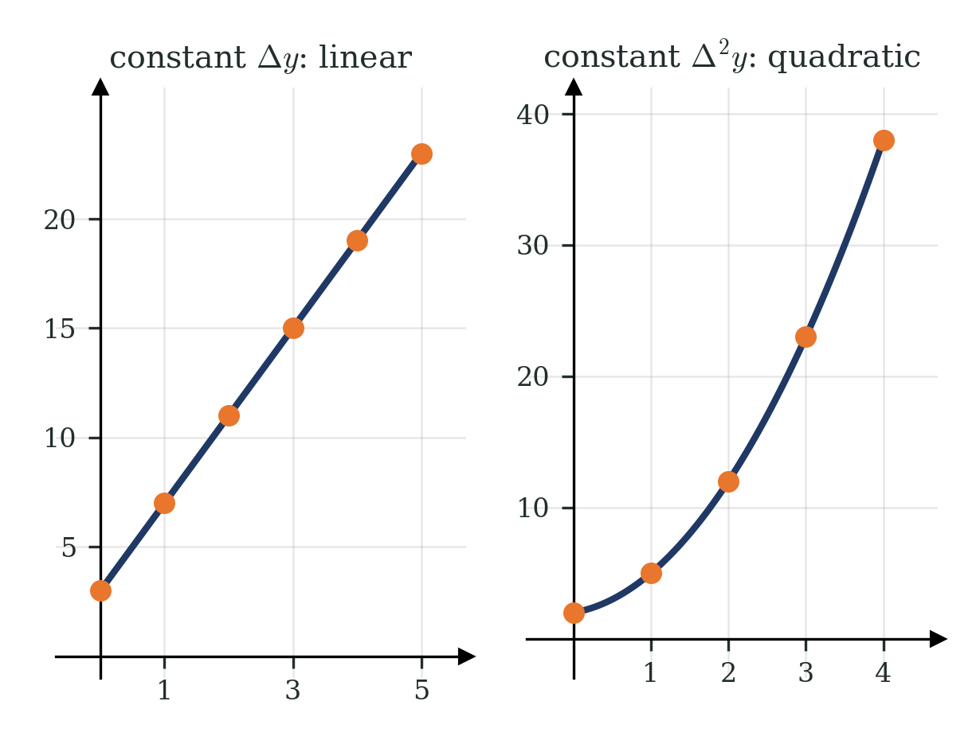
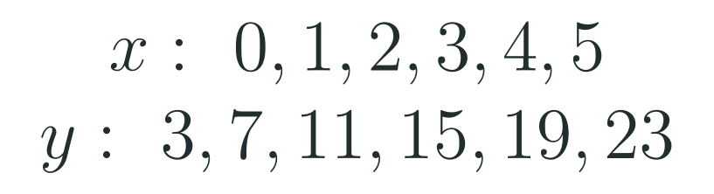
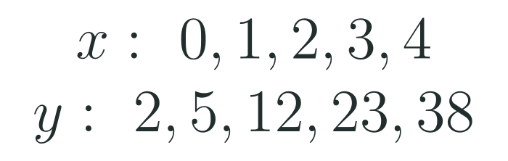




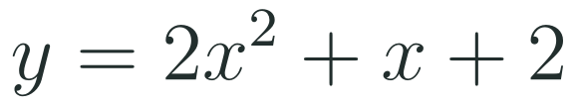
1
2
3
4
5
6
STATION 2 · TARGETED INSTRUCTION · 18 MIN
Choosing a function type from the data
EXAMPLE A
EXAMPLE B
LO 1.13.A · LO 1.13.B
FAITH, RIGHTEOUSNESS AND WISDOM
Mr Malek Thiab · 5
Notes:
Speaker notes (Targeted Instruction, block 1 of 3):
Speaker notes (Targeted Instruction, block 1 of 3, LO 1.13.A). EK 1.13.A.1: 'Linear functions model data sets or aspects of contextual scenarios that demonstrate roughly constant rates of change.' EK 1.13.A.2: 'Quadratic functions model data sets or aspects of contextual scenarios that demonstrate roughly linear rates of change, or data sets that are roughly symmetric with a unique maximum or minimum value.'
Worked solutions: Example A: the inputs step by 1 and every output rises by 4, so the rate is constant and the model is linear; slope 4, y-intercept 3: y = 4x + 3. Example B: first differences 3, 7, 11, 15 are not constant, second differences 4, 4, 4 are, so the model is quadratic with 2a = 4, a = 2. Using (0, 2): c = 2; using (1, 5): 2 + b + 2 = 5, b = 1. So y = 2x^2 + x + 2; check x = 3: 18 + 3 + 2 = 23.
Verbal misconceptions: 'differences that change mean the data is not a function'; 'the second difference equals a' (it equals 2a for unit steps).
Adaptive routing: if more than 30% miss Gate Q1, return to this slide and tabulate the differences for Example B.

Slide 6

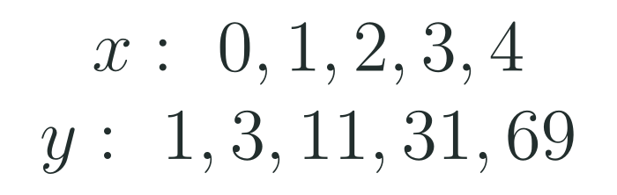
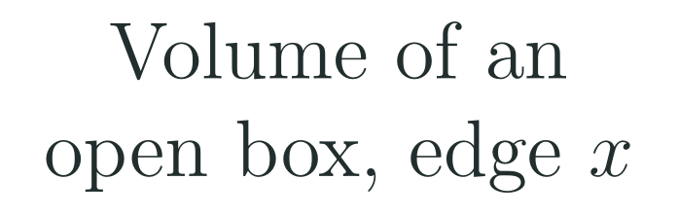



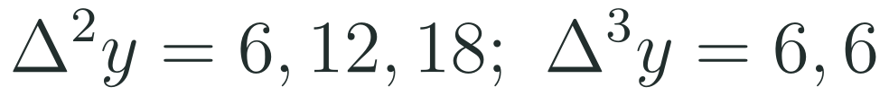
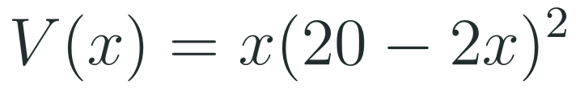



1
2
3
4
5
6
STATION 2 · TARGETED INSTRUCTION · 18 MIN
Degree n and geometric contexts
EXAMPLE A
EXAMPLE B
EXAMPLE C
LO 1.13.A · LO 1.13.B
FAITH, RIGHTEOUSNESS AND WISDOM
Mr Malek Thiab · 6
Notes:
Speaker notes (Targeted Instruction, block 2 of 3):
Speaker notes (Targeted Instruction, block 2 of 3, LO 1.13.A). EK 1.13.A.3: 'Geometric contexts involving area or two dimensions can often be modeled by quadratic functions. Geometric contexts involving volume or three dimensions can often be modeled by cubic functions.' EK 1.13.A.5: 'A polynomial function of degree n models data sets or contextual scenarios that demonstrate roughly constant nonzero nth differences.' EK 1.13.A.6: 'A polynomial function of degree n or less can be used to model a graph of n + 1 points with distinct input values.'
Worked solutions: Example A: the table is y = x^3 + x + 1. First differences 2, 8, 20, 38; second 6, 12, 18; third 6, 6. The third differences are constant, so the degree is 3. Example B: cutting squares of side x from a 20 by 20 sheet leaves a base of side 20 - 2x and height x, so V = x(20 - 2x)^2; expanding gives 4x^3 - 80x^2 + 400x, degree 3. Example C: n + 1 = 6 means n = 5, so some polynomial of degree at most 5 passes through all six points.
Verbal misconceptions: 'a polynomial through the points must be the true model' (fitting is not the same as explaining); 'six points need degree 6'.
Adaptive routing: if more than 30% miss Gate Q1 or Q3, return to this slide and redo Example A and Example C.

Slide 7
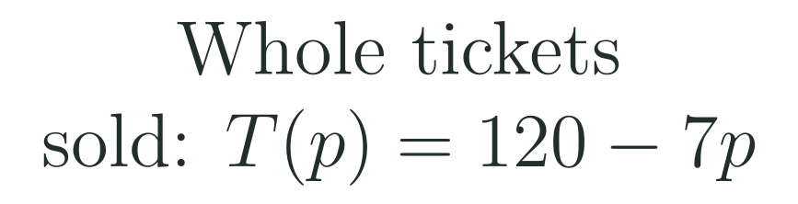
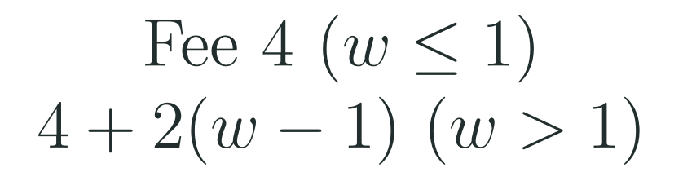

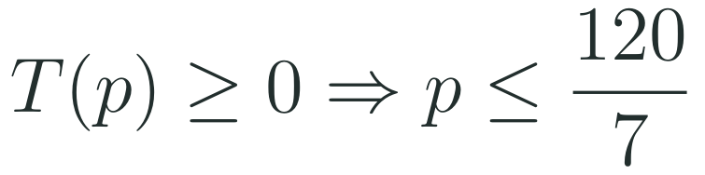




1
2
3
4
5
6
STATION 2 · TARGETED INSTRUCTION · 18 MIN
Assumptions and restrictions
EXAMPLE A
EXAMPLE B
EXAMPLE C
LO 1.13.A · LO 1.13.B
FAITH, RIGHTEOUSNESS AND WISDOM
Mr Malek Thiab · 7
Notes:
Speaker notes (Targeted Instruction, block 3 of 3):
Speaker notes (Targeted Instruction, block 3 of 3, LO 1.13.B). EK 1.13.B.1: 'A model may have underlying assumptions about what is consistent in the model.' EK 1.13.B.2: 'A model may have underlying assumptions about how quantities change together.' EK 1.13.B.3: 'A model may require domain restrictions based on mathematical clues, contextual clues, or extreme values in the data set.' EK 1.13.B.4: 'A model may require range restrictions, such as rounding values, based on mathematical clues, contextual clues, or extreme values in the data set.' EK 1.13.A.7 (piecewise-defined functions) is quoted from the fetched CED text.
Worked solutions: Example A: the base side 20 - 2x must be positive, so x < 10, and the height x must be positive: domain 0 < x < 10. Example B: tickets cannot be negative, so p <= 120/7 (about 17.14); a count of tickets is a whole number, so the outputs are rounded: a range restriction. Example C: the fee rises at 0 per kilogram up to 1 kg and 2 per kilogram after, so the rate of change is not constant: use a piecewise-defined function.
Verbal misconceptions: 'a model is valid for every real x'; 'a restriction is only needed when the formula has a fraction or a root'.
Adaptive routing: if more than 30% miss Gate Q2, return to this slide and redo Example A.

Slide 8
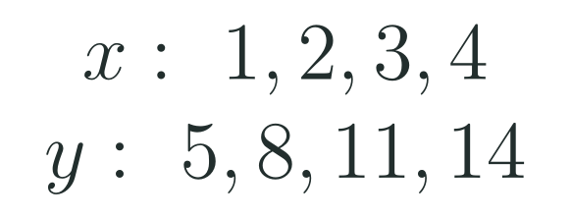
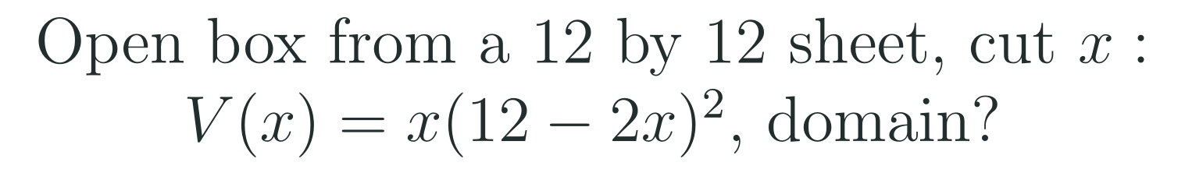
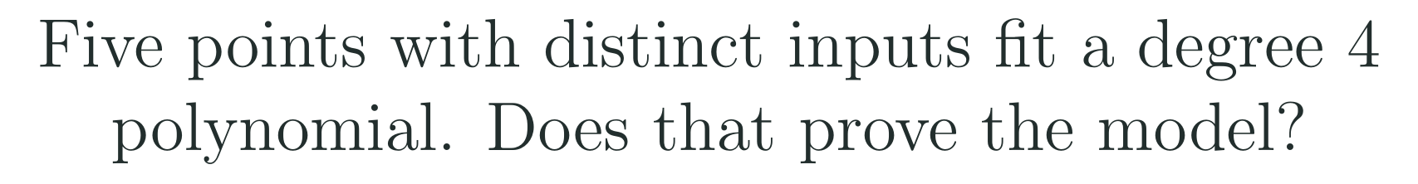
1
2
3
4
5
6
STATION 3 · PRACTICE · 12 MIN
Give it a go: Practice, Apply, Investigate
PRACTICE
APPLY
INVESTIGATE
Secure the method
Use it in context
Find out why
Done when: you name the function type from the differences and write its equation.
Done when: you state the domain as an inequality and say which length forces each end.
Done when: your explanation separates fitting the data from justifying the model type.
LO 1.13.A · LO 1.13.B
FAITH, RIGHTEOUSNESS AND WISDOM
Mr Malek Thiab · 8
Notes:
Speaker notes (Practice, 12 min; tierless differentiation: students choose the starting column and may move across):
Speaker notes (Practice, 12 min; tierless: students choose the starting column and may move across).
Answers: Practice: first differences 3, 3, 3: linear with slope 3; y = 3x + 2. Apply: base side 12 - 2x > 0 gives x < 6 and height x > 0: domain 0 < x < 6. Investigate: any n + 1 points with distinct inputs lie on some polynomial of degree n or less, so a fit through five points is always possible and says nothing about whether the context behaves that way; the model type needs a reason from the context (constant rate, area, volume).
Verbal misconceptions: 'a perfect fit proves the model'.
Adaptive routing: finished students move to Apply then Investigate; stuck students return to slide 5.

Slide 9
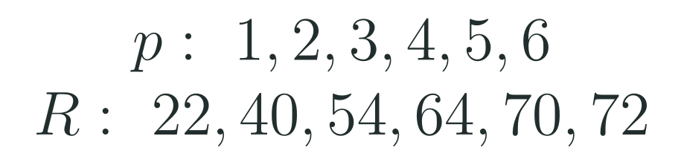
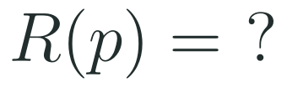
1
2
3
4
5
6
STATION 4 · PRODUCTION · 12 MIN
Production: ticket revenue for a science fair
THE MODEL
DONE WHEN
A school science fair sells tickets. The table gives the revenue R in hundreds of dollars, for each ticket price p in dollars. The numbers are model values for practice, not real data.
Both rows of differences are shown.
The equation is checked against two table values.
The prediction at 8 dollars is given with units.
The restriction and the assumption are each stated in a full sentence.
Find the first and second differences and choose the function type.
Find the equation of R and predict the revenue at a price of 8 dollars.
State a domain restriction and one assumption of the model.
Hint: the second differences are constant, so the model is quadratic: start from a quadratic with three unknown coefficients.
LO 1.13.A · LO 1.13.B
FAITH, RIGHTEOUSNESS AND WISDOM
Mr Malek Thiab · 9
Notes:
Speaker notes (Production, 12 min):
Speaker notes (Production, 12 min).
Solutions: first differences 18, 14, 10, 6, 2; second differences -4, -4, -4, -4: constant, so quadratic with 2a = -4 and a = -2. Using R(1) = 22: -2 + b + c = 22; R(2) = 40: -8 + 2b + c = 40; subtracting gives b = 24 and c = 0, so R(p) = -2p^2 + 24p. Check p = 6: -72 + 144 = 72. R(8) = -128 + 192 = 64 hundred dollars, 6400 dollars. The greatest revenue is at p = 6 (72 hundred dollars). Restriction: R >= 0 needs 0 <= p <= 12, so p lies in [0, 12]. Assumption: for example, the number of buyers falls steadily as the price rises, and nothing else about the fair changes.
Verbal misconceptions: stopping at the first differences; reading 64 as 64 dollars (it is hundreds of dollars).
Adaptive routing: if students cannot start, send them to slide 5 Example B and the hint.

Slide 10
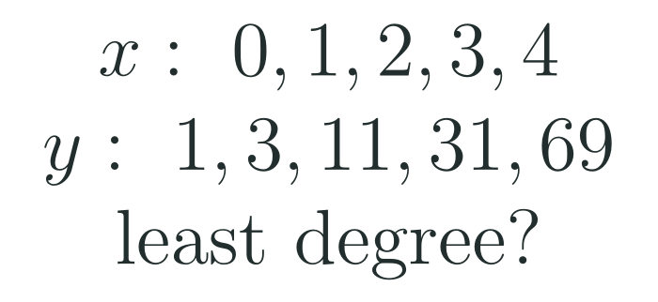
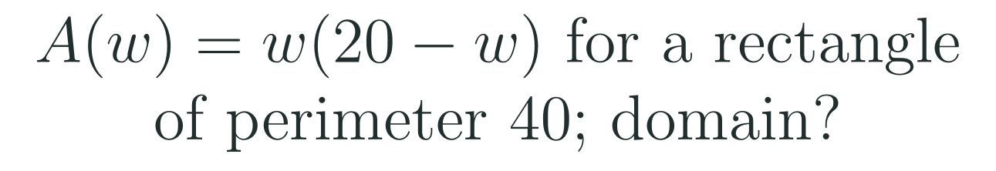
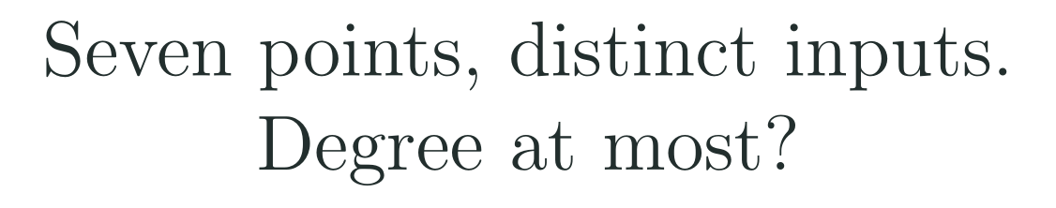
1
2
3
4
5
6
STATION 5 · MASTERY GATE · 6 MIN
Mastery Gate: three questions to pass
1
2
3
Pass mark
3 of 3 correct unlocks Station 6. Fewer than that: return to the slide for the question you missed, redo it, then re-take the gate.
LO 1.13.A · LO 1.13.B
FAITH, RIGHTEOUSNESS AND WISDOM
Mr Malek Thiab · 10
Notes:
Speaker notes (Mastery Gate, 6 min, no calculator):
Speaker notes (Mastery Gate, 6 min, no calculator).
Answers: Q1 first differences 2, 8, 20, 38; second 6, 12, 18; third 6, 6: degree 3. Q2 both w > 0 and 20 - w > 0, so the domain is 0 < w < 20. Q3 n + 1 = 7, so n = 6: degree at most 6.
Verbal misconceptions: Q1 'stop at the second differences and say quadratic'; Q2 'domain is all real numbers'; Q3 'degree 7'.
Adaptive routing: Q1 missed, route to slide 6 Example A; Q2 missed, route to slide 7 Example A; Q3 missed, route to slide 6 Example C.

Slide 11
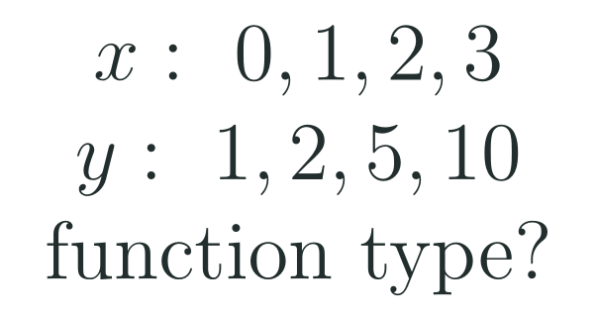
1
2
3
4
5
6
STATION 6 · SMART PRODUCTION · 6 MIN
Smart Production: make one, then check it
CREATE
TIME TO CHECK
Write a real-life scenario that a quadratic model fits and explain why in one sentence.
Write one domain restriction and one assumption for your model.
Swap with a partner: they check that the reason uses a rate of change, a shape or a geometric fact.
Exit ticket: write your answer on a sticky note and place it on the door.
Done when: your partner confirms the model type, the restriction and the assumption.
Next lesson: Topic 1.14 Function Model Construction and Application.
LO 1.13.A · LO 1.13.B
FAITH, RIGHTEOUSNESS AND WISDOM
Mr Malek Thiab · 11
Notes:
Speaker notes (Smart Production, 6 min):
Speaker notes (Smart Production, 6 min).
Exit answer: first differences 1, 3, 5; second differences 2, 2: quadratic (y = x^2 + 1).
Verbal misconceptions: students say linear because the outputs increase; ask: are the first differences equal?

Slide 12
Journey complete
Targeted Instruction
Production
Smart Production
✓
✓
✓
✓
✓
✓
Diagnose
Practice
Mastery Gate
Read the type from the differences, the geometry or the shape, then state the assumptions and the domain and range restrictions that make the model fit the context.
FAITH, RIGHTEOUSNESS AND WISDOM
Notes:
Speaker notes: Every station is checked off. Recap in one sentence: Read the type from the differences, the geometry or the shape, then state the assumptions and the domain and range restrictions that make the model fit the context. Collect the Time to Check responses. Next lesson: Topic 1.14 Function Model Construction and Application.

